Slide 1

Busting into freelance non-fiction
HANDOUTS
Suzanne Mattaboni
Novelist, PR Director,
Journalist, Podcaster
suzanne@mattaboni.com
suzannemattaboni.com
onceinalifetimenovel.com
Twitter @suzmattaboni
facebook.com/suzanne.mattaboni
Instagram suzannemattaboni80s,
Suzanne Mattaboni80s
GenX Book Club podcasts
Banzai Retro Club podcasts
ON AMAZON HERE!

Slide 2
BUSTING INTO FREELANCE NON-FICTION
Trade, Hobbyist, and Association Magazines
Most are now online, but you’ll be able to find at least one or two trade journals or associations on just about ANY SUBJECT.
Search for “[SUBJECT X] magazines” on Google, look into each one to see which suits you. Note the location (you’ll often get listings from the UK and India). Stay regional if possible.
Notice which publications and articles are being “served” to you from social media or other electronic sources. That might be a good starting point. They know what you like.

Slide 3
TYPES OF MATERIAL
How-to articles: Very popular. Provide specific tips and advice for people wanting to get into your profession, succeed at a certain task, deal with stress, entertain their children, find the right make-up…
“Top Lists” or “listicles”: Top 5 Ways to yada yada. Also very popular.
Q&A interviews: Have any interesting friends or co-workers? Or, identify a professional in your field and ask them for an interview. Prepare questions beforehand. Share Qs with the subject beforehand if they request them.
Opinion pieces: Have a novel point of view, or something you think needs to be expressed? Organize your thoughts. Do not rant—show evidence/examples.
First person experiences: If you’ve tried something cool like hiking a trail, learning a new sport, volunteering at cancer camp, write something thoughtful.

Slide 4
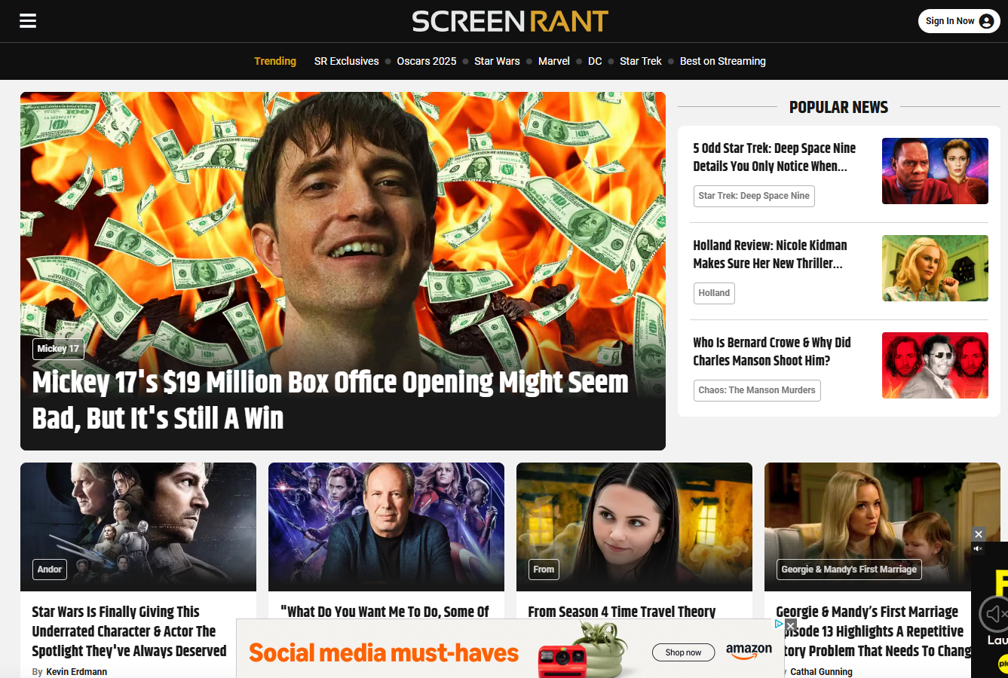
PLATFORM-BASED E-ZINES/COMMUNITIES
SCREENRANT PopSugar Bored Panda Medium
Many online mags have a “write for us” page with guidelines.
Several have programs where you join their freelance stable online and are obligated to turn in 3 or more stories per week, paid per-story. Check LinkedIn job ads.
Others are not paid, but you can submit articles on a WordPress type platform and the editors will either accept or reject them.
Articles are typically 500 – 1,000 words.
DO NOT USE CHATGPT – bigger magazines have tools to root out its use. Some places will not work with you again if they determine you are using AI (or any other sources that might lead to plagiarism.)

Slide 5

THE BUSINESS OF FREELANCING
Payment: Many sources pay per word. Some, you may not be paid at all, especially at first—but it’s a good way to get some freelance writing samples.
Some pay per project, and you set the fee. Decide what your rate should be per hour ($30 - $100 depending on your experience & the market), then estimate how many hours the project would take.
Taxes: You’ll be a 1099 employee. They won’t take out taxes, so it’s recommended that you put aside 25% of each check into a separate account to pay in taxes later. If you are completely freelance, you will need to pay taxes quarterly, depending on how you declare yourself (sole proprietor, S Corporation, LLC, etc.)
In referencing yourself, you can’t say you work for any of the companies you freelance for. You are a contributor, or you can say your work has appeared in said publication.
You can declare yourself a business in PA just by starting a D.B.A (“doing business as”) bank account. Can also get an EIN number from the state, or file as a corporation. Can do this on your own fairly easily; some people go through a lawyer.

