Slide 1


Success with Short Fiction:
HANDOUTS
Anthologies and Contests
Suzanne Mattaboni
Suzanne Mattaboni
Author, PR Consultant, Podcaster
suzanne@mattaboni.com
suzannemattaboni.com
onceinalifetimenovel.com
Twitter @suzmattaboni
facebook.com/suzanne.mattaboni
Instagram suzannemattaboni80s, Suzanne Mattaboni80s
GenX Book Club podcasts
Banzai Retro Club podcasts
On Amazon HERE.

Slide 2

Short Stories
Success with Short Fiction: Anthologies and Contests
Length most frequently requested by anthologies and magazines: 2,500 – 5,000 words
Some accept flash fiction under 1,500 words
Structure: Should have the same arc as a novel –beginning, middle and end, where a character realizes a change in him/herself
Payment is not notable for anthologies or magazines. Many do not pay; they offer copies of the final product, or a nominal sum ($15?)
Are a great way to bulk up your bio and add credibility

Slide 3
Success with Short Fiction: Anthologies and Contests
Anthologies
Are often themed, holiday, or genre-based.
Sci-fi, horror, speculative, literary fiction are popular. Global or marginalized voices are becoming more prevalent.
Some accept combinations of flash fiction, poetry, or essays.
Many have submission entry fees – but most small magazines/presses are run on a shoestring.
Most are associated with independent editors or publishers.
“Chicken Soup for the Soul” franchise is constantly posting calls for themed anthologies, many times with inspirational themes.
If you publish enough stories, you can pitch your own short story collection (40K words minimum).

Slide 4
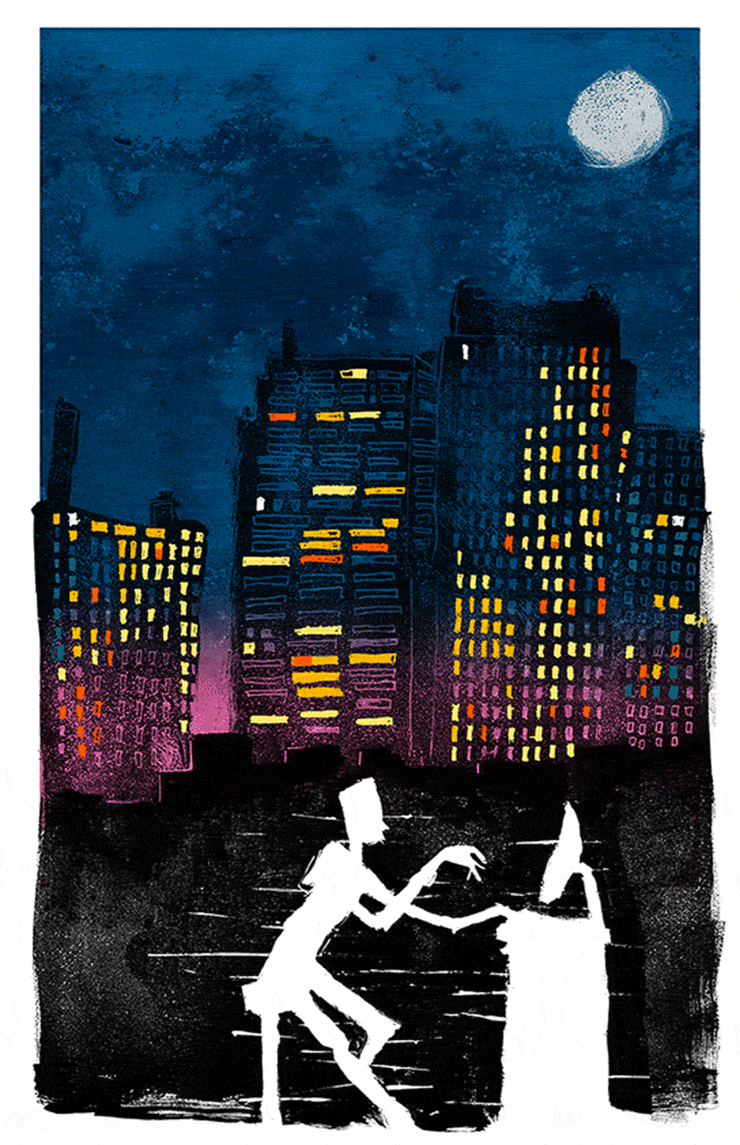
Submissions
Success with 1Short Fiction: Anthologies and Contests
Many use the Submittable platform. Bonus: this platform also advertises submission calls.
Follow submission guidelines. Some are very specific, (type of file, font, subject line).
Cover email saying something about the story, word count, plus some bio info.
Important: Find the editor’s name and address that person. It’s usually somewhere on the site under “team” or “staff.” They don’t like to see “Dear Editor.”
Spell that person’s name correctly. Cut and paste it.

Slide 5


Diving into Magazines
Success with Short Fiction: Anthologies and Contests
Magazines often cater to genres: Sci-Fi, Fantasy, Horror, Mystery, Thriller, Literary
Women’s magazines/romance is a smaller market for short format… but Woman’s World pays $800 for an 800 Word “5 Minute Romance”
Typically pay per-word
More online magazines are cropping up every day: parenting, health, travel, hobbies, etc.
Online writing platforms like Medium & Channillo pay per reader/subscriber
Research each magazine – read at least one of their stories, more if possible.
Similar submission process. Follow guidelines, find editors’ names, etc.

Slide 6

Resources
Success with Short Fiction: Anthologies and Contests
Published to Death https://publishedtodeath.blogspot.com/
Facebook Calls for Submissions https://www.facebook.com/groups/35517751475
Authors Publish https://authorspublish.com/
Horror Tree (horror/sci fi)https://horrortree.com/
Duotrope https://duotrope.com/
Freedom with Writing https://www.freedomwithwriting.com/freedom/
Submittable “Discover” Tab (account required) https://manager.submittable.com/opportunities/discover
Poets & Writers: Literary Magazines page https://www.pw.org/literary_magazines
Submittable Discover Tab: https://manager.submittable.com/opportunities/discover
Make a Living Writing https://makealivingwriting.com/where-to-sell-short-stories/
The Write Life https://thewritelife.com/where-to-submit-short-stories/
Reedsy https://blog.reedsy.com/where-to-submit-short-stories/
Freelance Articles List: https://harpoonapp.com/blog/post/magazines-that-accept-freelance-articles
Writers’ Market Novel and Short Story Market on Amazon

